Slide 1
Jaggaer – Supplier portal
Onboarding Support

Slide 2
Onboarding phase

Slide 3
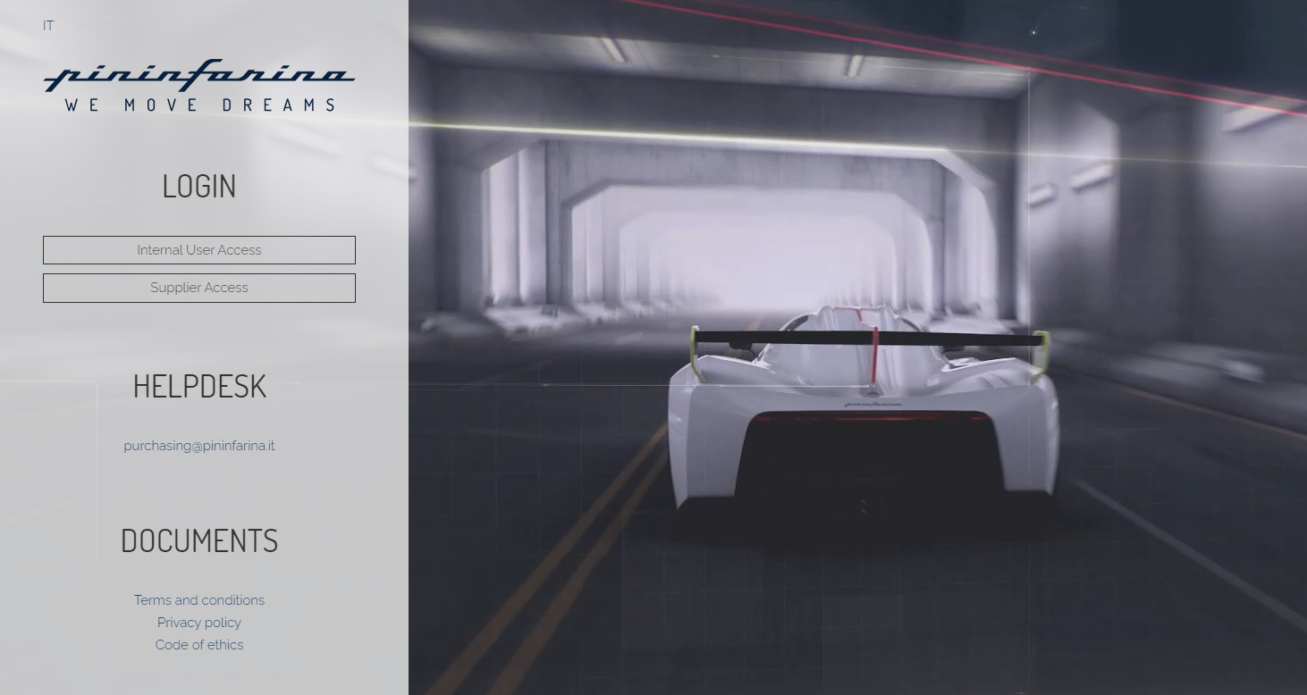
1° step: Click on «Supplier Access» and then «New registration». In case you will find the homepage in Italian language, you can switch to English clicking on «EN/IT» on top left.

Slide 4
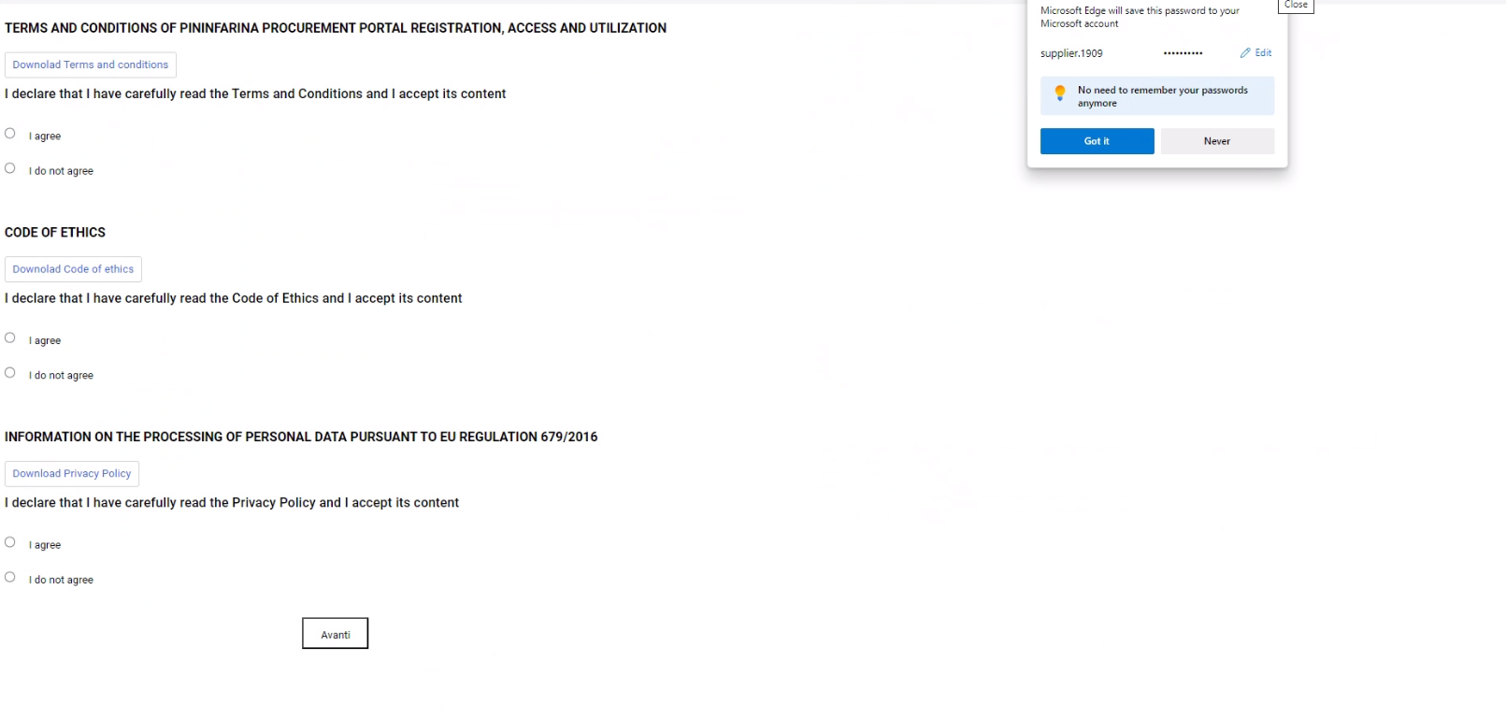
2° step: download, read and sign:
    Terms and Conditions;
    Code of Ethics;
    Privacy Policy

Slide 5
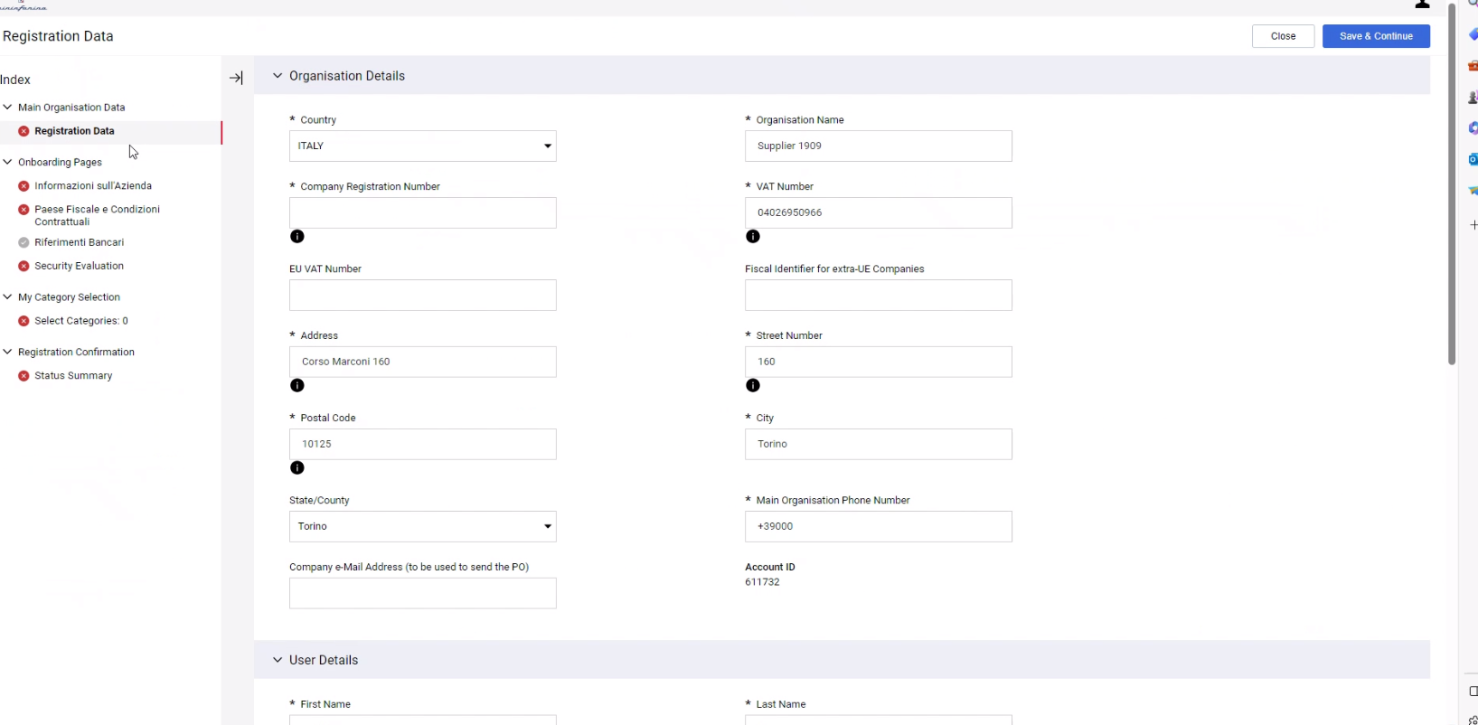
3° step: Fill all the informations you see above. Keep in mind that all the fields marked with red «*» are mandatory.

Slide 6
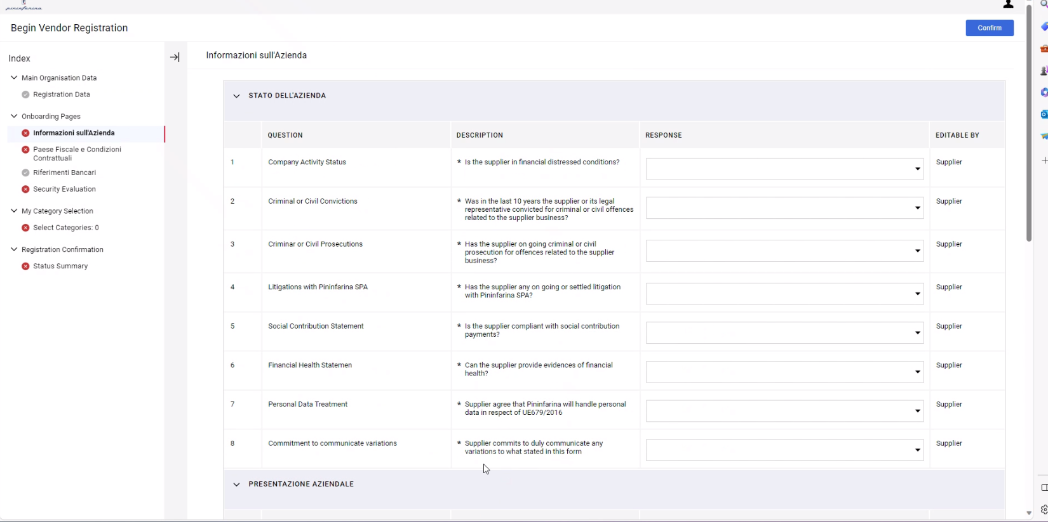
4° step: Fill all the «Company Informations» you see above.

Slide 7
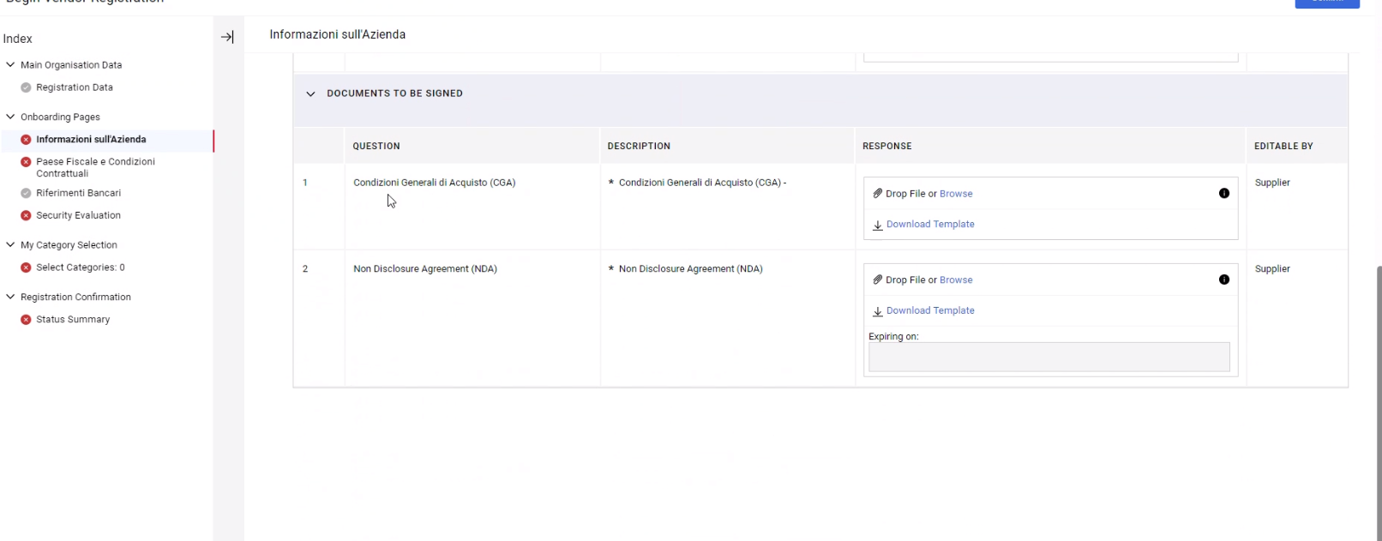
5° step: Still on «Company Informations» area, you have to download, fill, sign and upload again the General Purchasing Terms & Conditions (CGA) and Non disclosure agreement (NDA) you will find at the bottom page.

Slide 8
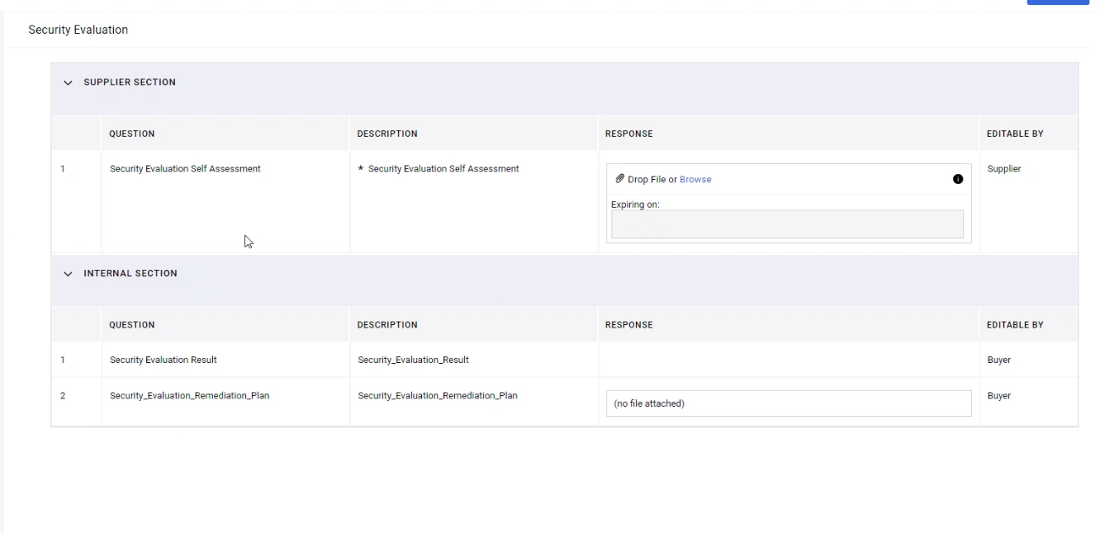
6° step: On «Security Evaluation» area, you have to download, fill, sign and upload again the Security Evaluation Self Assessment.

Slide 9
Categories evaluation phase

Slide 10
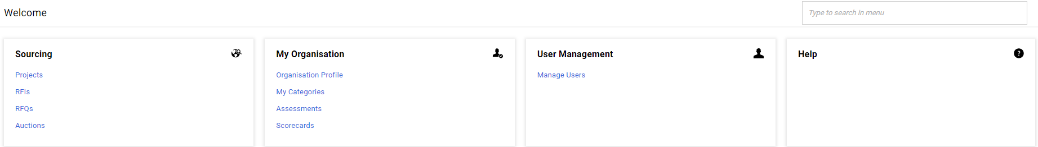
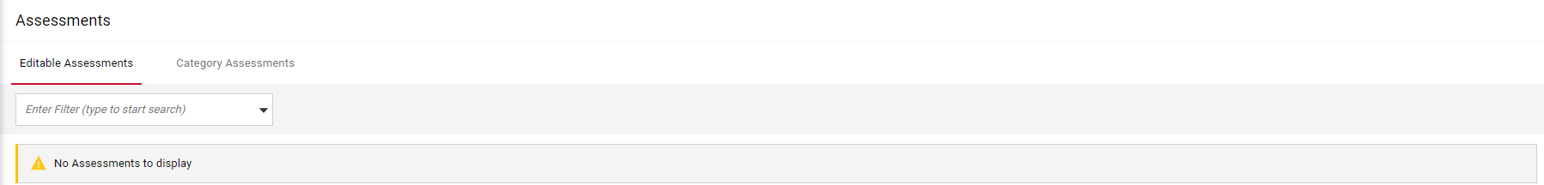
1° step: My organisation ----> Assessments;
2° step: Editable assessments ----> Where you see «No assessments to display» in the image above, you will find the categories you have chosen during the registration process;

Slide 11
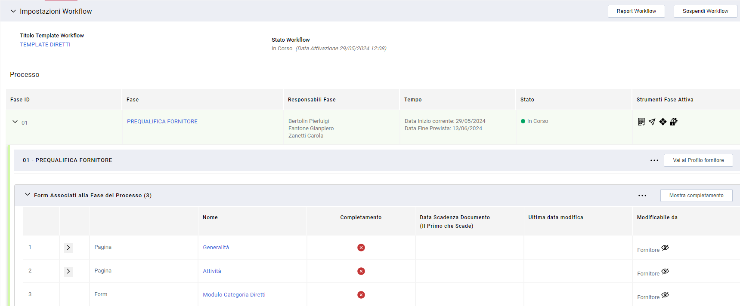
3° step: You have to fill all the informations and documentation included in each of the 3 fields you will find on this page. A red «X» next to fields name mean that there are missing mandatory informations or documents.

